Slide 1

Notes:
Reload codespace
Update settings.json.
Uncheck VS Code tabs except for Terminal
Hide Activity Bar
Hide Explorer
Remove comments from any pre-made code

Slide 2
This is CS50
On today's snack menu, chocolate chip cookies. 🍪
If you'd like to attend CS50 Lunch this Fri 10/10 at 1:15pm, RSVP at cs50.ly/lunch!
We'll be joined by alumni from Meta.
Do say hi or ask questions during break or after class!
What do today's binary bulbs spell?

Slide 4
data structures
Notes:
may seem arcane but lots of data structures in world

Slide 5

Notes:
https://www.youtube.com/watch?v=ItAG3s6KIEI
Prof. Shannon Duvall of Elon University

Slide 6
abstract data types

Slide 7
queues
Notes:
- waiting in line

Slide 8
FIFO

Slide 9
enqueue
dequeue

Slide 10
const int CAPACITY = 50;
typedef struct
{
person people[CAPACITY];
int size;
} queue;
Notes:
If you don't keep track of the head of the queue, have to keep shifting everyone within array.

Slide 11
stacks
Notes:
- stack of sweaters
- Gmail inbox

Slide 12
LIFO

Slide 13
push
pop

Slide 14
const int CAPACITY = 50;
typedef struct
{
person people[CAPACITY];
int size;
} stack;

Slide 15
dictionaries

Slide 17
word | definition

Slide 18
name | number

Slide 19
key | value

Slide 20

Notes:
https://apps.apple.com/us/app/contacts/id1069512615#?platform=iphone

Slide 21
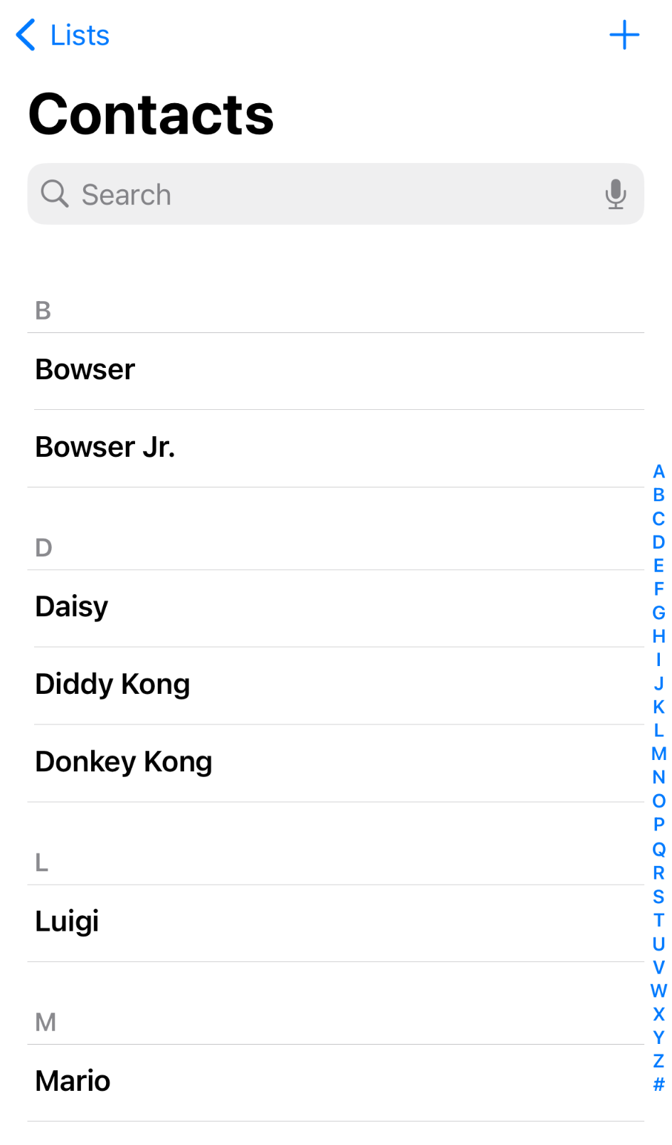
Notes:
https://nintendo.fandom.com/wiki/Nintendo_characters#Mario_series_(including_sub-franchises)

Slide 22
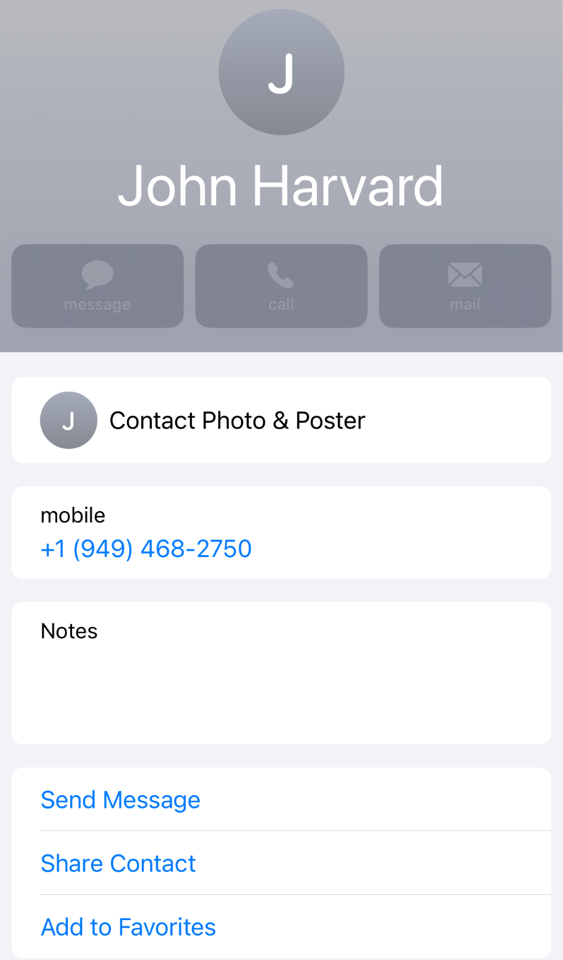

Slide 23
arrays

Slide 25
 | 1 | 2 | 3
Notes:
list0.c

Slide 26
 | 1 | 2 | 3

Slide 27
 | 1 | 2 | 3

Slide 28

 | 1 | 2 | 3 | h | e | l | l
o | , |  | w | o | r | l | d
\0

Slide 29
 | 1 | 2 | 3

Slide 30
 | 1 | 2 | 3
 | 1

Slide 31
 | 1 | 2 | 3
 | 1 | 2

Slide 32
 | 1 | 2 | 3
 | 1 | 2 | 3

Slide 33
 | 1 | 2 | 3
 | 1 | 2 | 3 | 4

Slide 34
 | 1 | 2 | 3 | 4
Notes:
list{1,2}.c

Slide 35
data structures

Slide 36
struct
.
*

Slide 37
struct
->

Slide 38
linked lists

Slide 40
 |  | 1 0x123

Slide 41
 |  | 1 0x123
 |  |  |  | 2 0x456

Slide 42
 |  | 1 0x123
 |  |  |  | 2 0x456
 |  |  |  |  |  | 3 0x789

Slide 43
 |  | 1 0x123
 |  |  |  | 2 0x456
 |  |  |  |  |  | 3 0x789

Slide 44
 |  | 1 0x123
 |  | 0x456 |  | 2 0x456
 |  |  |  |  |  | 3 0x789

Slide 45
 |  | 1 0x123
 |  | 0x456 |  | 2 0x456
 |  |  |  | 0x789 |  | 3 0x789

Slide 46
 |  | 1 0x123
 |  | 0x456 |  | 2 0x456
 |  |  |  | 0x789 |  | 3 0x789
 |  |  |  |  |  | 0x0

Slide 47
 |  | 1 0x123
 |  | 0x456 |  | 2 0x456
 |  |  |  | 0x789 |  | 3 0x789
 |  |  |  |  |  | NULL

Slide 48
 |  | 1 0x123
 |  | 0x456 |  | 2 0x456
0x123 |  |  |  | 0x789 |  | 3 0x789
 |  |  |  |  |  | NULL

Slide 49
 |  | 1
 |  |  |  | 2
 |  |  |  |  |  | 3

Slide 50
typedef struct
{
string name;
string number;
} person;

Slide 51
typedef struct
{
char *name;
char *number;
} person;

Slide 52
typedef struct
{
} person;

Slide 53
typedef struct
{
} node;

Slide 54
typedef struct
{
int number;
} node;

Slide 55
typedef struct
{
int number;
node *next;
} node;

Slide 56
typedef struct node
{
int number;
node *next;
} node;

Slide 57
typedef struct node
{
int number;
struct node *next;
} node;
Notes:
list3.c (to show prepending)

Slide 59
node *list;

Slide 60
node *list;
list

Slide 61
node *list = NULL;
list

Slide 62
node *list = NULL;
list

Slide 63
node *n = malloc(sizeof(node));
list

Slide 64
node *n = malloc(sizeof(node));
list
n

Slide 65
node *n = malloc(sizeof(node));
list
number
n
next

Slide 66
node *n = malloc(sizeof(node));
list
number
n
next

Slide 67
(*n).number = 1;
list
number
n
next

Slide 68
(*n).number = 1;
list
1
number
n
next

Slide 69
n->number = 1;
list
1
number
n
next

Slide 70
n->next = NULL;
list
1
number
n
next

Slide 71
n->next = NULL;
list
1
number
n
next

Slide 72
list = n;
list
1
number
n
next

Slide 73
list = n;
list
1
number
n
next

Slide 74
list
1

Slide 75
node *n = malloc(sizeof(node));
list
1

Slide 76
node *n = malloc(sizeof(node));
list
1
n

Slide 77
node *n = malloc(sizeof(node));
list
1
n

Slide 78
node *n = malloc(sizeof(node));
list
1
n

Slide 79
n->number = 2;
list
1
n

Slide 80
n->number = 2;
list
2
1
n

Slide 81
n->next = NULL;
list
2
1
n

Slide 82
n->next = NULL;
list
2
1
n

Slide 83
list
2
1
n

Slide 84
list = n;
list
2
1
n

Slide 85
list = n;
list
2
1
n

Slide 86
list = n;
list
2
1
n

Slide 87
list
2
1
n

Slide 88
n->next = list;
list
2
1
n

Slide 89
n->next = list;
list
2
1
n

Slide 90
list = n;
list
2
1
n

Slide 91
list = n;
list
2
1
n

Slide 92
list
2
1

Slide 93
list
2
1
3
Notes:
list4.c (to show printing with while loop)

Slide 94
ptr
list
2
1
3

Slide 95
ptr
list
2
1
3

Slide 96
ptr
list
2
1
3

Slide 97
ptr
list
2
1
3

Slide 98
list
2
1
3
Notes:
list5.c (for loop instead)

Slide 99
O(n²)
O(n log n)
O(n)
O(log n)
O(1)

Slide 100
list

Slide 101
list
1

Slide 102
list
2
1

Slide 103
list
2
1
3

Slide 104
O(n²)
O(n log n)
O(n)
O(log n)
O(1)

Slide 105
O(n²)
O(n log n)
O(n)
O(log n)
O(1)
Notes:
list6.c (freeing, after showing valgrind on list5)

Slide 106
O(n²)
O(n log n)
O(n) search
O(log n)
O(1) insertion

Slide 107
O(n²)
O(n log n)
O(n) search, deletion
O(log n)
O(1) insertion

Slide 108
list

Slide 109
list
1

Slide 110
2
list
1

Slide 111
2
list
1
3

Slide 112
O(n²)
O(n log n)
O(n)
O(log n)
O(1)
Notes:
list7.c (append)

Slide 113
O(n²)
O(n log n)
O(n) search, deletion, insertion
O(log n)
O(1)

Slide 114
list

Slide 115
list
2

Slide 116
list
2
1

Slide 117
4
list
2
1

Slide 118
4
list
2
3
1

Slide 119
O(n²)
O(n log n)
O(n)
O(log n)
O(1)
Notes:
list8.c (sorted)
list9.c (freeing memory after errors)

Slide 120
O(n²)
O(n log n)
O(n) search, deletion, insertion
O(log n)
O(1)
Notes:
list8.c (sorted)

Slide 121

Notes:
https://emojipedia.org/apple/ios-18.4/cookie

Slide 122
arrays

Slide 123
linked lists

Slide 124
trees

Slide 125
binary search trees

Slide 126
 | 1 | 2 | 3 | 4 | 5 | 6 | 7

Slide 127
 | 1 | 2 | 3 | 4 | 5 | 6 | 7

Slide 128
 | 1 | 2 | 3 | 4 | 5 | 6 | 7

Slide 129
 | 1 | 2 | 3 | 4 | 5 | 6 | 7

Slide 130
4
2
6
1
3
5
7

Slide 131
4
2
6
1
3
5
7
Notes:
each square is an abstraction of a node now, no need to keep drawing rects

Slide 132
typedef struct node
{
int number;
struct node *next;
} node;

Slide 133
typedef struct node
{
int number;
} node;

Slide 134
typedef struct node
{
int number;
} node;

Slide 135
typedef struct node
{
int number;
struct node *left;
struct node *right;
} node;

Slide 136
4
2
6
1
3
5
7

Slide 137
bool search(node *tree, int number)
{
if (tree == NULL)
{
return false;
}
else if (number < tree->number)
{
return search(tree->left, number);
}
else if (number > tree->number)
{
return search(tree->right, number);
}
else if (number == tree->number)
{
return true;
}
}

Slide 138
bool search(node *tree, int number)
{
if (tree == NULL)
{
return false;
}
else if (number < tree->number)
{
return search(tree->left, number);
}
else if (number > tree->number)
{
return search(tree->right, number);
}
else if (number == tree->number)
{
return true;
}
}

Slide 139
bool search(node *tree, int number)
{
if (tree == NULL)
{
return false;
}
else if (number < tree->number)
{
return search(tree->left, number);
}
else if (number > tree->number)
{
return search(tree->right, number);
}
else if (number == tree->number)
{
return true;
}
}

Slide 140
bool search(node *tree, int number)
{
if (tree == NULL)
{
return false;
}
else if (number < tree->number)
{
return search(tree->left, number);
}
else if (number > tree->number)
{
return search(tree->right, number);
}
else if (number == tree->number)
{
return true;
}
}

Slide 141
bool search(node *tree, int number)
{
if (tree == NULL)
{
return false;
}
else if (number < tree->number)
{
return search(tree->left, number);
}
else if (number > tree->number)
{
return search(tree->right, number);
}
else if (number == tree->number)
{
return true;
}
}

Slide 142
bool search(node *tree, int number)
{
if (tree == NULL)
{
return false;
}
else if (number < tree->number)
{
return search(tree->left, number);
}
else if (number > tree->number)
{
return search(tree->right, number);
}
else if (number == tree->number)
{
return true;
}
}

Slide 143
4
2
6
1
3
5
7

Slide 144
Notes:
What if we build a BST from scratch, starting with 2?

Slide 145
2

Slide 146
2
1
Notes:
then 1

Slide 147
2
1
3
Notes:
then 3. looks fine.

Slide 148
Notes:
what if the insertion order is 1-2-3 instead?

Slide 149
1

Slide 150
1
2

Slide 151
1
2
3

Slide 152
O(n²)
O(n log n)
O(n)
O(log n)
O(1)

Slide 153
O(n²)
O(n log n)
O(n)
O(log n)
O(1)

Slide 154
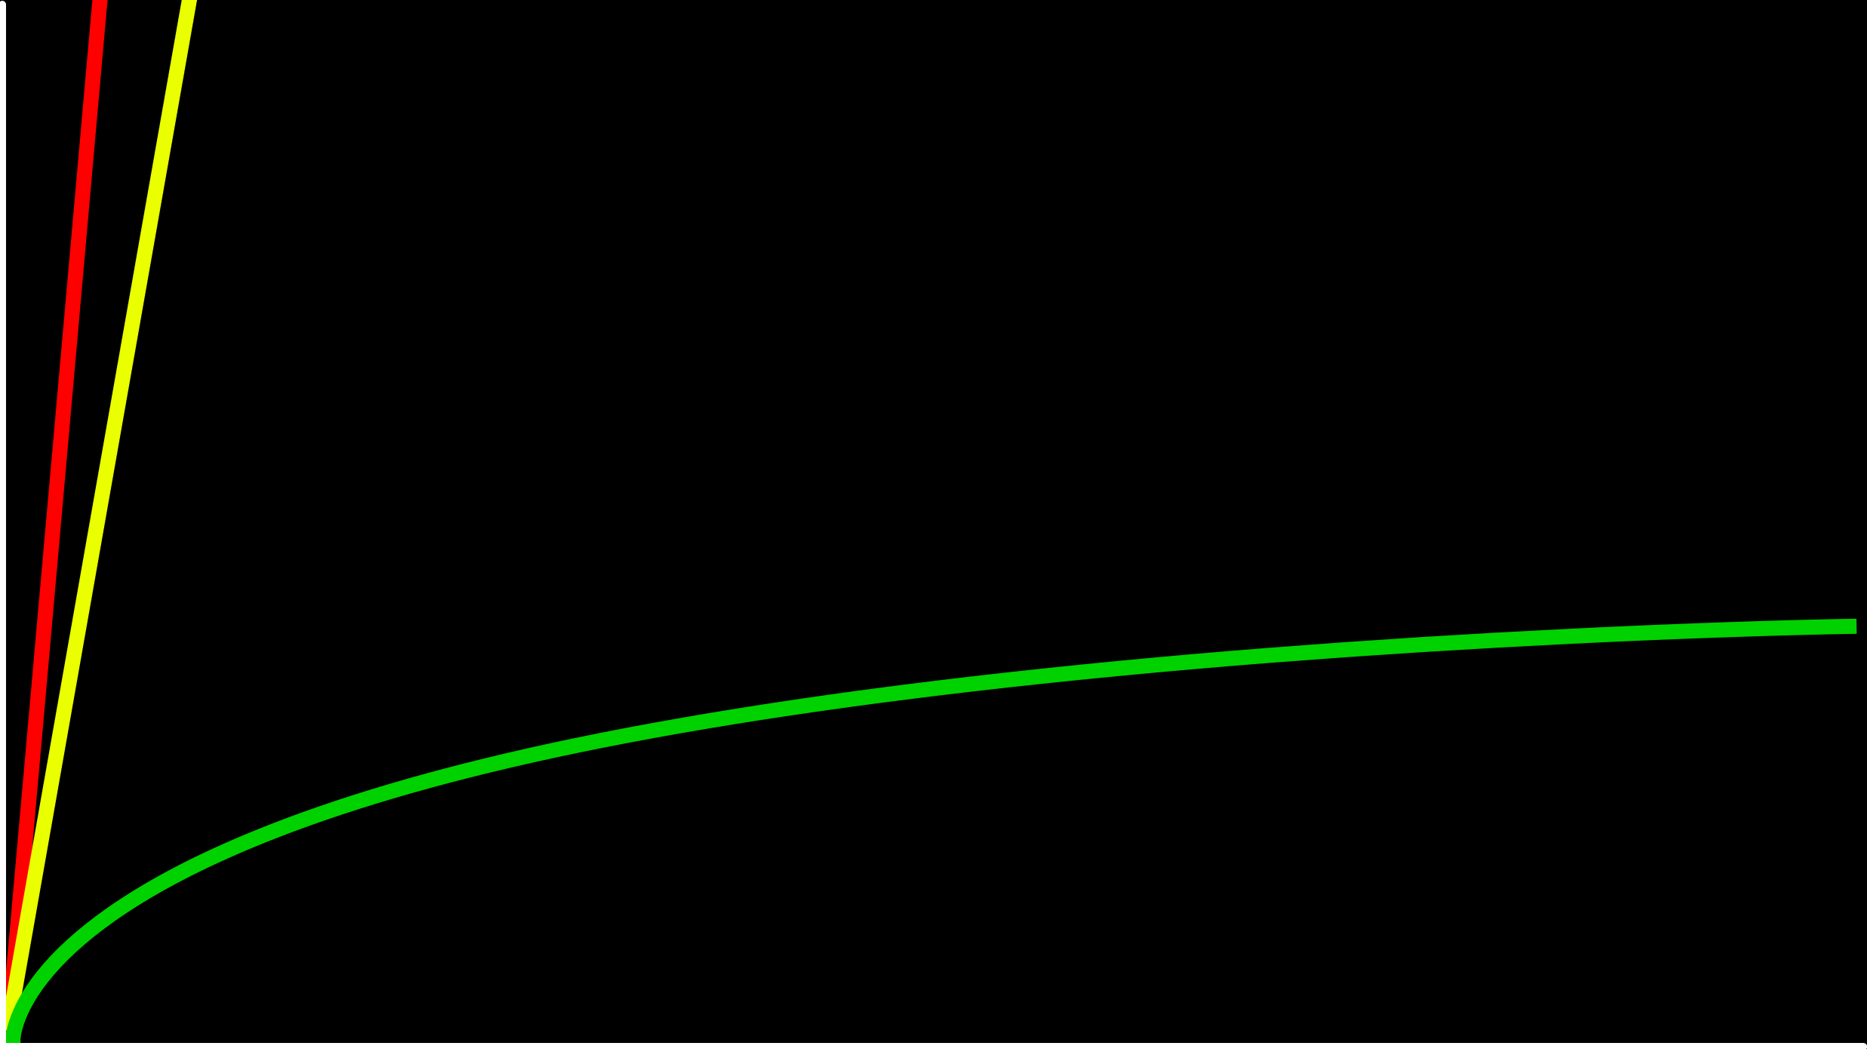
O(n)
time to solve
O(log n)
size of problem

Slide 155
O(n)
time to solve
O(log n)
O(1)
size of problem

Slide 156
hashing

Slide 157
hash function
Notes:
cards into buckets

Slide 158
Notes:
https://apps.apple.com/us/app/contacts/id1069512615#?platform=iphone

Slide 159
input →
→ output

Slide 160
hash function

Slide 161
Mario →
→ 12

Slide 162
Luigi →
→ 11

Slide 163
#include <ctype.h>
int hash(char *name)
{
return toupper(name[0]) - 'A';
}

Slide 164
#include <ctype.h>
int hash(const char *name)
{
return toupper(name[0]) - 'A';
}

Slide 165
#include <ctype.h>
unsigned int hash(const char *name)
{
return toupper(name[0]) - 'A';
}

Slide 166
hash tables

Slide 167
node *table[26];

Slide 168
typedef struct
{
char *name;
char *number;
} person;

Slide 169
typedef struct node
{
char *name; struct node *next;
} node;

Slide 171
0
1
2
3
4
5
6
7
8
9
10
11
12
13
14
15
16
17
18
19
20
21
22
23
24
25

Slide 172
A
B
C
D
E
F
G
H
I
J
K
L
M
N
O
P
Q
R
S
T
U
V
W
X
Y
Z

Slide 174
Mario

Slide 175
Luigi
Mario

Slide 176
Luigi
Mario
Peach

Slide 177
Birdo
Daisy
Goomba
Isabelle
King Boo
Luigi
Mario
Peach
Rosalina
Shy Guy
Toad
Wario
Yoshi
Zelda

Slide 178
Birdo
Daisy
Goomba
Isabelle
King Boo
Luigi
Lakitu
Mario
Peach
Rosalina
Shy Guy
Toad
Wario
Yoshi
Zelda

Slide 179
Birdo
Daisy
Goomba
Isabelle
King Boo
Luigi
Lakitu
Link
Mario
Peach
Rosalina
Shy Guy
Toad
Wario
Yoshi
Zelda

Slide 180
Birdo
Bowser
Bowser Jr.
Daisy
Donkey Kong
Diddy Kong
Dry Bones
Goomba
Ganon
Isabelle
King Boo
K.K. Slider
Luigi
Lakitu
Link
Mario
Peach
Petey Piranha
Rosalina
Shy Guy
Spike
Toad
Toadette
Tom Nook
Wario
Waluigi
Yoshi
Zelda

Slide 181
O(n²)
O(n log n)
O(n)
O(log n)
O(1)

Slide 182
O(n²)
O(n log n)
O(n)
O(log n)
O(1)

Slide 183
Laa
Lab
Lac
Lad
Lae
Laf
Lag
Lah
Lai
Laj
Lak
...
Lim
Lin
Lio
...
Luh
Lui
Luj
Lakitu
Link
Luigi
Notes:
17,576 buckets

Slide 184
O(n)

Slide 185
O(n/k)

Slide 186
O(n)

Slide 187
O(1)

Slide 188
tries

Slide 189
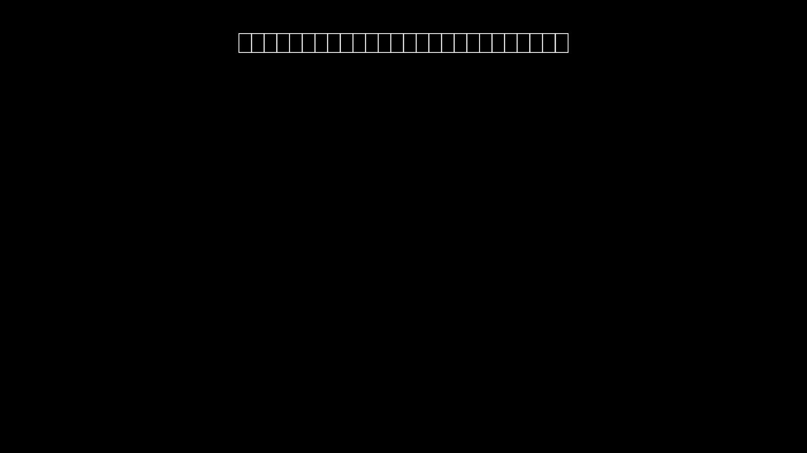

Slide 190
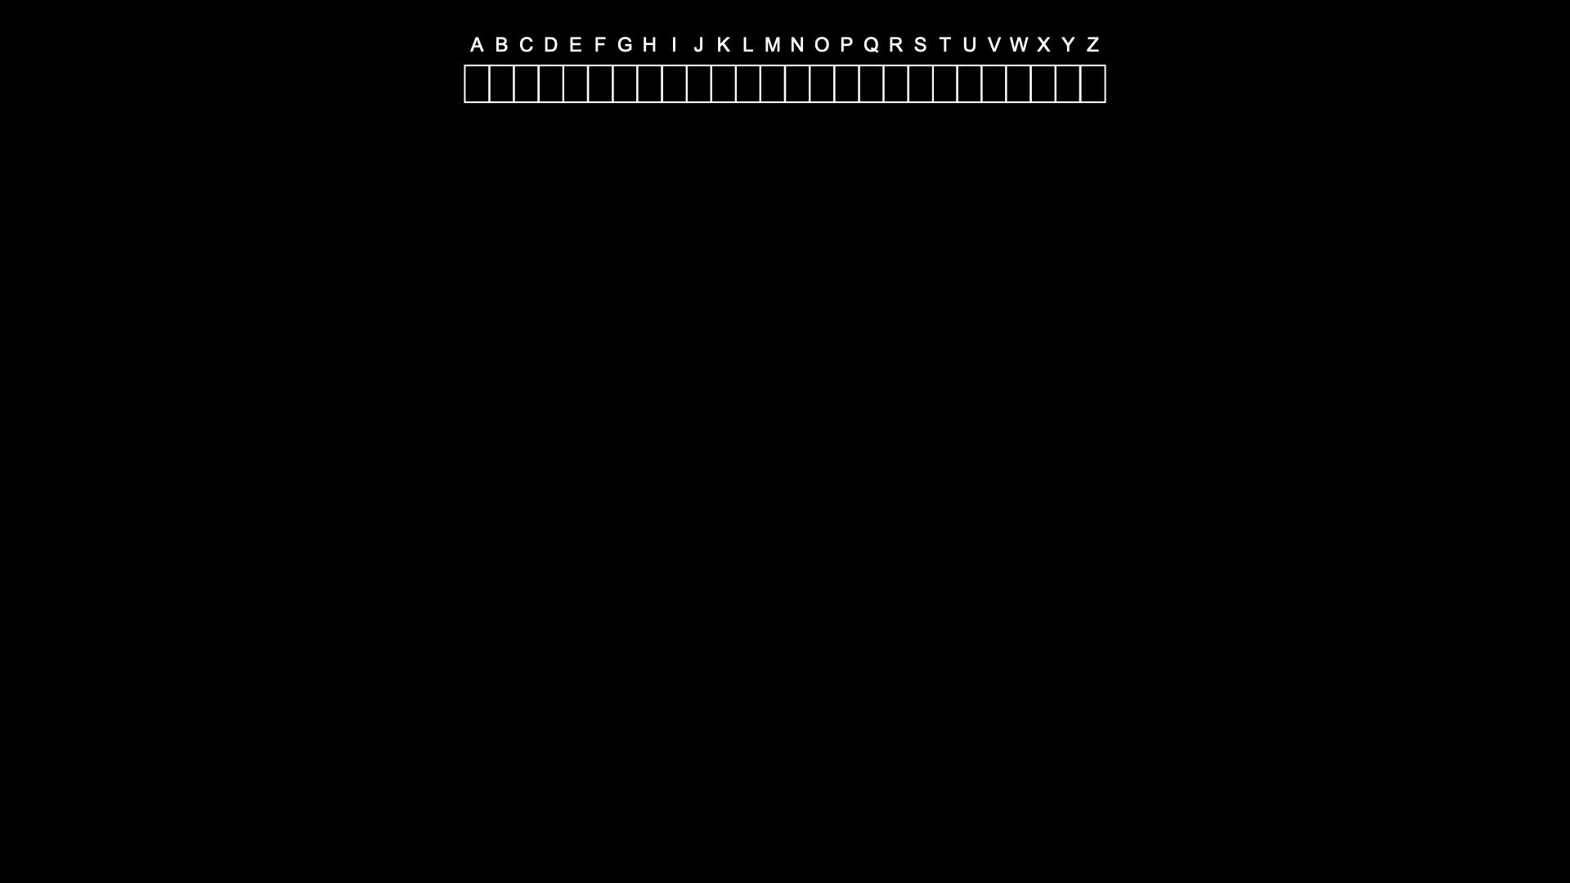

Slide 191
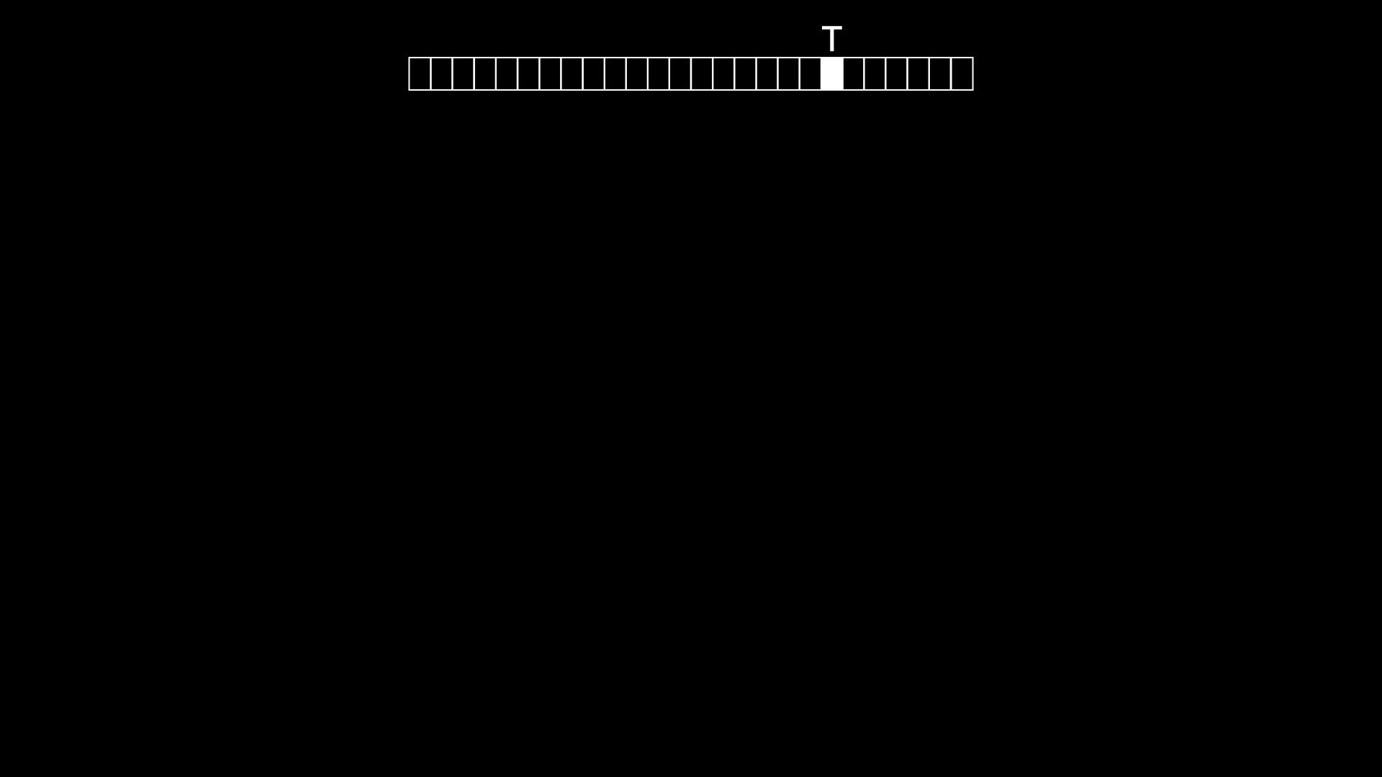

Slide 192
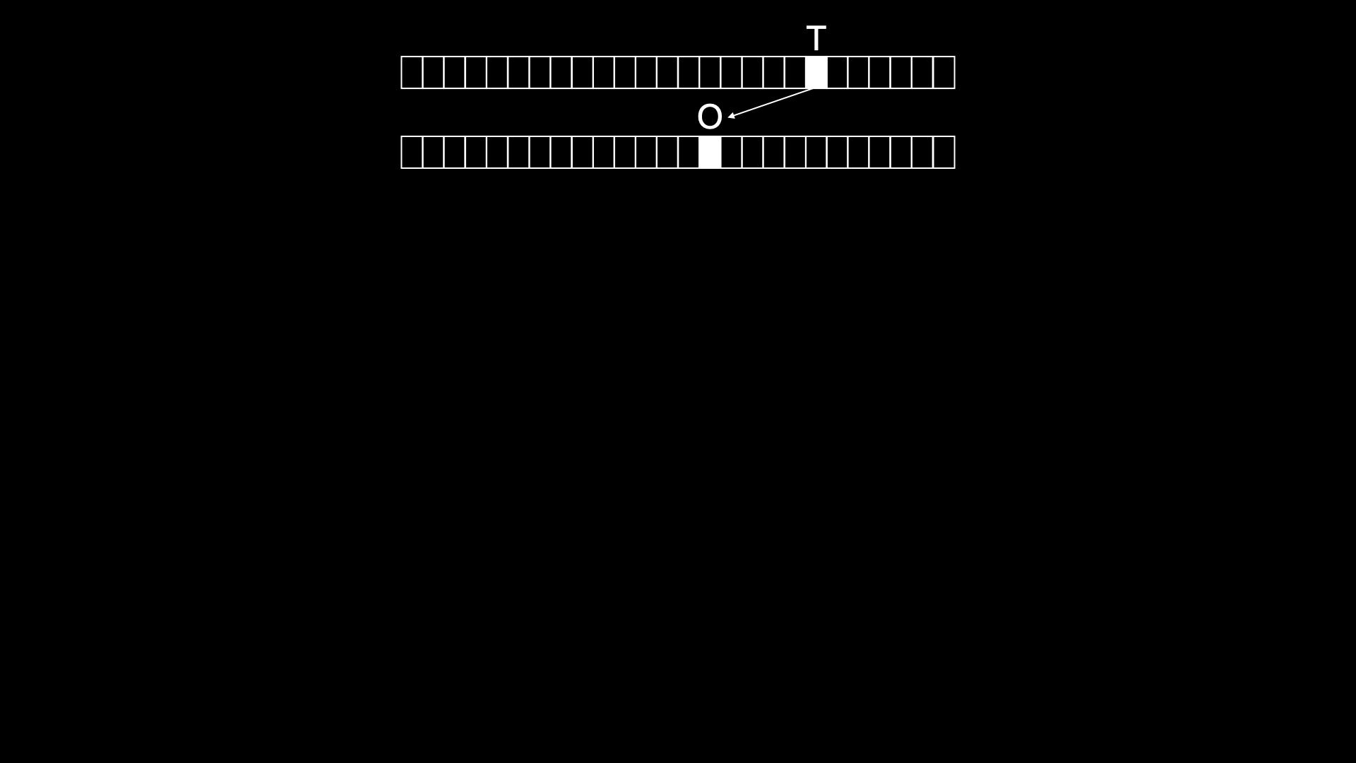

Slide 193
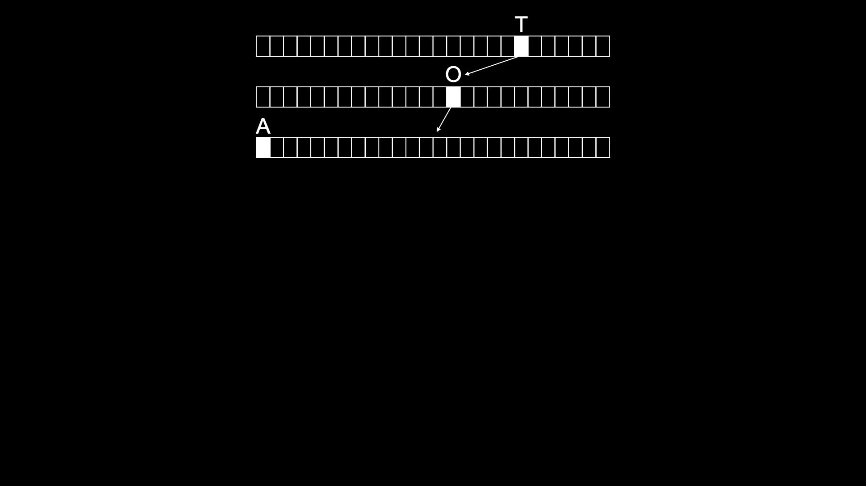

Slide 194
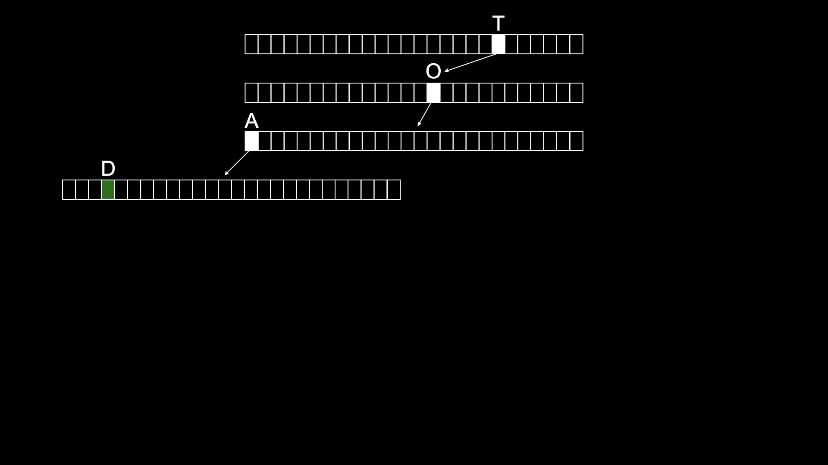

Slide 195
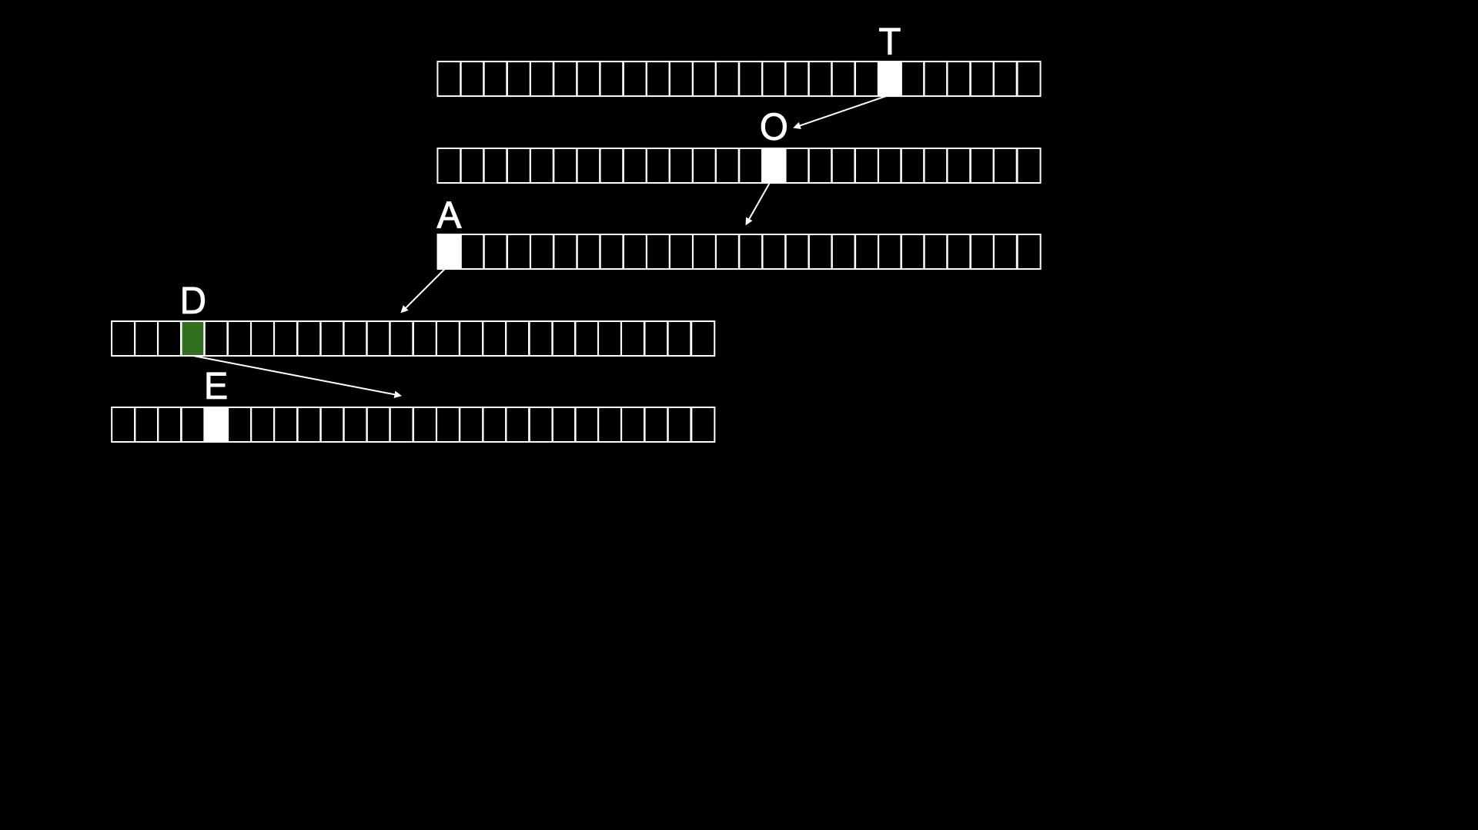

Slide 196
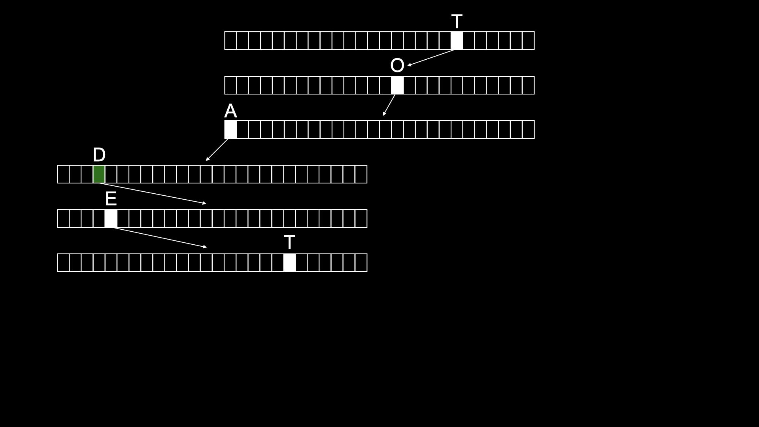

Slide 197
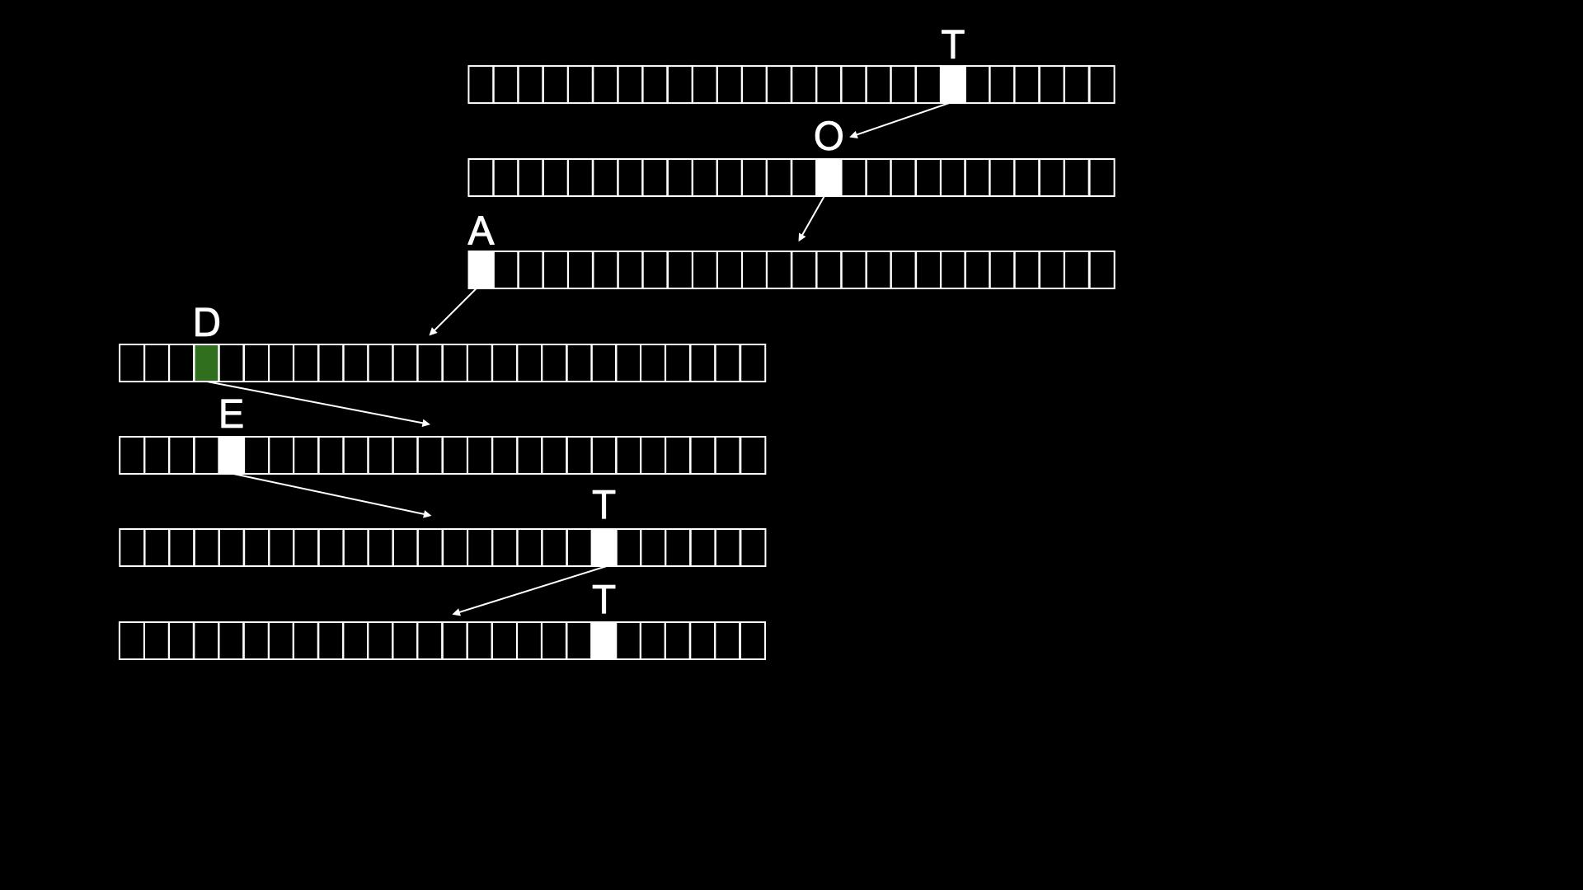

Slide 198
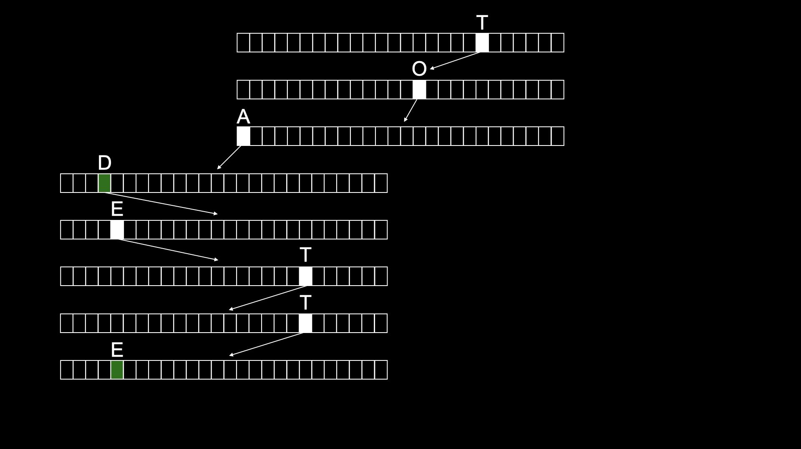

Slide 199
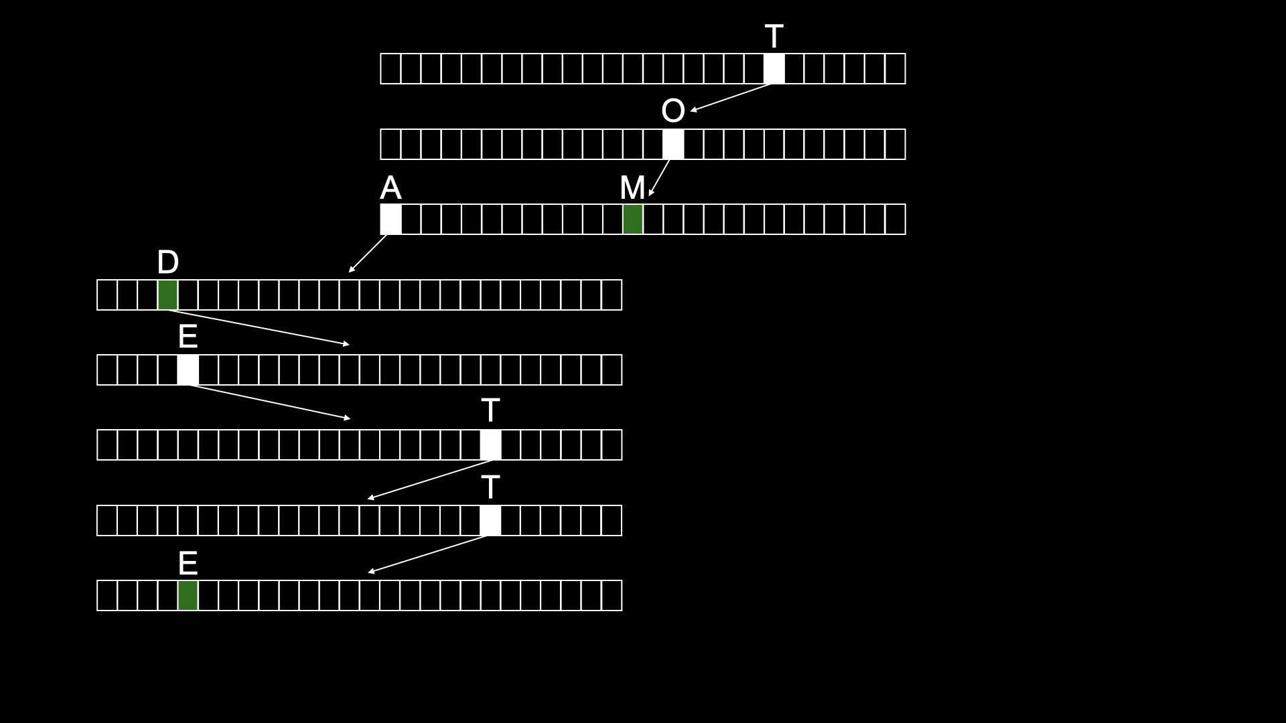

Slide 200
typedef struct node
{
struct node *children[26];
char *number;
} node;
Notes:
don't need to bother storing name, since implicit in trie

Slide 201
node *trie;

Slide 202
O(n²)
O(n log n)
O(n)
O(log n)
O(1)

Slide 203
